Slide 1
Kuipp – Product layout & Design
Design & Functionality

Slide 2
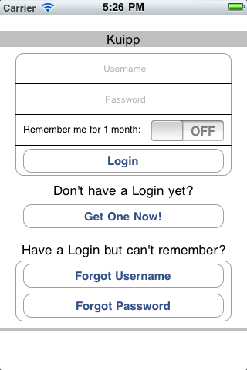
General Instructions and To Do
General Instructions and To Do
General Instructions
Black Box – RETURNS user to previous page
YELLOW BOX – REFRESHES current page
(NYI) means it’s ‘NOT YET IMPLEMENTED’
To Do
Implement Core Location
for Map,
Inputting correct location data
Finding city/regions
Implement Search Bars
Fill out Settings
Implement keyboard scrollview
When a keyboard appears, the view will scroll up so the textbox/textfield will always be visible
Implement textbox functions
Currently the only way to get rid of the keyboard for a textbox is to click on the background (the done key starts a new line instead of exiting out of the textbox)
Implement inserting multiple Messages/Friends
Create a way to search all questions instead of just your following’s
Create a way to search all users instead of just your hierarchy

Slide 3
Login
Login
How to get here:
Launch App without a stored session
Or: Directory > Settings > ‘Logout’
Username – username of the user
Password – password of the user
Remember – ‘ON’ = 1 month, ‘OFF’ = 1 hour
Login
queries server for a session ID
SENDS user to Directory if successful
Get One Now! – SENDS user to Registration
Forgot Username – (NYI) SENDS user to retrieve username
Forgot Username – (NYI) SENDS user to retrieve/reset password

Slide 4
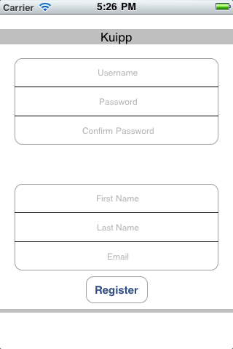
Registration
Registration
How to get here:
Login > Get One Now!
Username – username of the user
Password – password of the user
Confirm Password – password confirmation
First Name – first name of the user
Last Name – last name of the user
Email – email address of the user
Register
tries to insert a new user to server
RETURNS user to login if successful

Slide 5
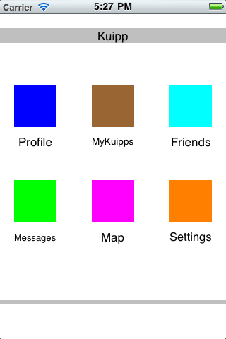
Directory
Directory
How to get here:
Launch App WITH a stored session
Or: Login
Profile – SENDS user to Profile
MyKuipps – SENDS user to MyKuipps
Friends – SENDS user to Friends
Messages – SENDS user to Messages
Map – SENDS user to Map
Settings – SENDS user to Settings

Slide 6
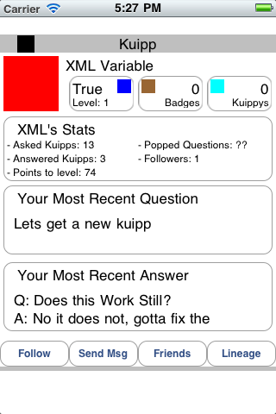
Profile
Profile
How to get here:
Directory > Profile
Or: Directory > MyKuipps > Following > user
Or: Directory > Friends > user
‘Profile’ – SENDS user to Profile
‘MyKuipps’ – SENDS user to MyKuipps
‘Friends’ – SENDS user to Friends
‘Messages’ – SENDS user to Messages
‘Map’ – SENDS user to Map
‘Settings’ – SENDS user to Settings

Slide 7
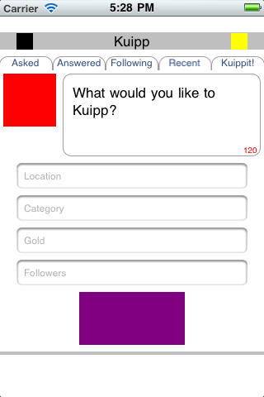
MyKuipps
MyKuipps
How to get here:
Directory > MyKuipps
Asked – SENDS user to MyKuipps - Asked
Answered – SENDS user to MyKuipps - Answered
Following – SENDS user to MyKuipps - Following
Recent – SENDS user to MyKuipps - Recent
Kuippit! – SENDS user to MyKuipps - Kuipps

Slide 8
MyKuipps – Kuippit!
MyKuipps – Kuippit!
How to get here:
Directory > MyKuipps
Or: Directory > MyKuipps > Kuippit!
Red Box – Kuipp Logo
Top Box – textbox for question
# in Top Box – (NYI) counts remaining letters
Location – (NYI) textbox for location name
Category – (NYI) textbox for category name
Gold – (NYI) textbox for answer incentive
Followers – (NYI) textbox for followers to ask
Purple Box
tries to insert new question to server
SEND user to Question

Slide 9
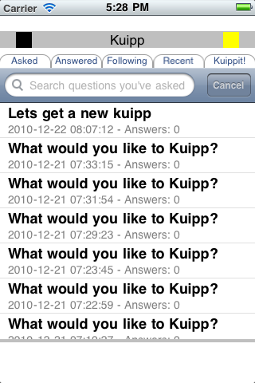
MyKuipps - Asked
MyKuipps - Asked
How to get here:
Directory > MyKuipps > Asked
Search Bar – (NYI) searches answers
question – SENDS user to Question

Slide 10
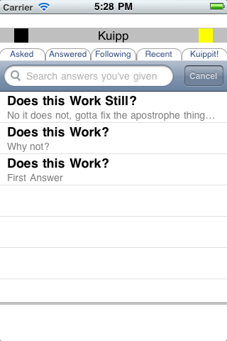
MyKuipps - Answered
MyKuipps - Answered
How to get here:
Directory > MyKuipps > Answered
Search Bar – (NYI) searches answers
answer – SENDS user to Answer

Slide 11
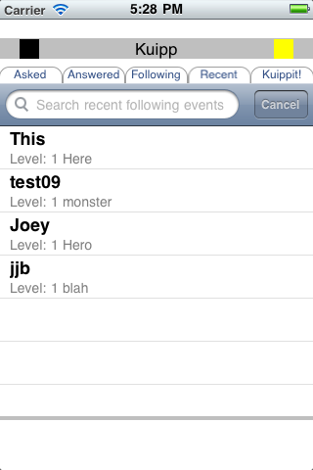
MyKuipps - Following
MyKuipps - Following
How to get here:
Directory > MyKuipps > Following
Search Bar – (NYI) searches users
user – SENDS user to Profile of user

Slide 12
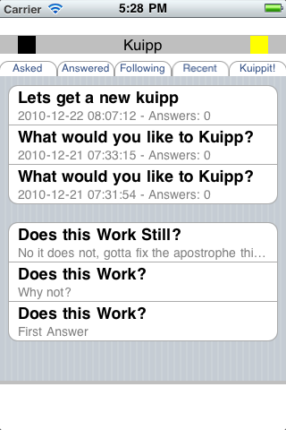
MyKuipps - Recent
MyKuipps - Recent
How to get here:
Directory > MyKuipps > Recent
Top Section
Recent questions user asked
will change to people they are following
question – SENDS user to Question
Bottom Section
Recent answers user answered
will change to people they are following
answer – SENDS user to Answer

Slide 13
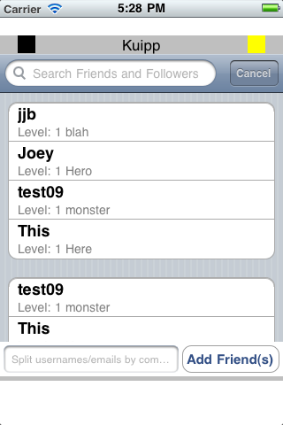
Friends
Friends
How to get here:
Directory > Friends
Search Bar – (NYI) searches users
Top Box
users you are following
user – SENDS user to Profile of user
Bottom Box
users following you
user – SENDS user to Profile of user
Add Friend(s) (NYI)
Input usernames or emails of users you want to follow separated by commas
add friend(s) (NYI)
tries to insert following to server
REFRESHES Friends

Slide 14
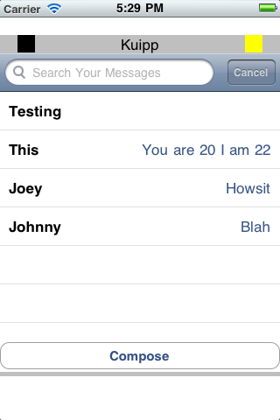
Messages
Messages
How to get here:
Directory > Messages
Search Bar – (NYI) searches messages
message – SENDS user to Message
Compose – SENDS user to Compose

Slide 15
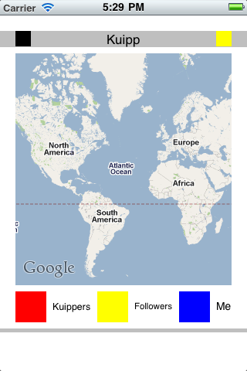
Map
Map
How to get here:
Directory > Map
Map
(NYI) zoom into user’s location
(NYI) displays local questions

Slide 16
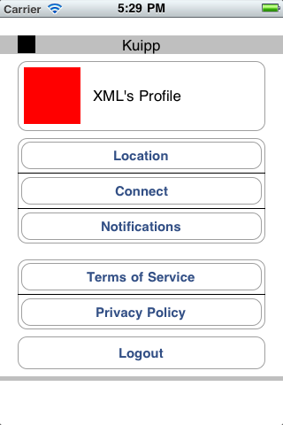
Settings
Settings
How to get here:
Directory > Settings
Red Box – user’s profile picture
XML’s… – user’s name
Location – (NYI) location privileges
Connect – (NYI) connect privileges
Notifications – (NYI) notification privileges
Terms of Service – (NYI) terms of service
Privacy Policy – (NYI) privacy policy
Logout
REMOVES stored session
SENDS user to Login

Slide 17
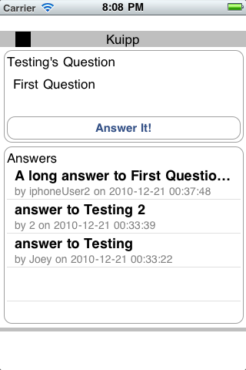
Question
Question
How to get here:
Directory > MyKuipps > Asked > question
Or: (need to make a way to search all questions)
Top Box
username’s question
Question
Answer It! – SENDS user to AnswerIt
Bottom Box
answers for the question
answer – SENDS user to Answer

Slide 18
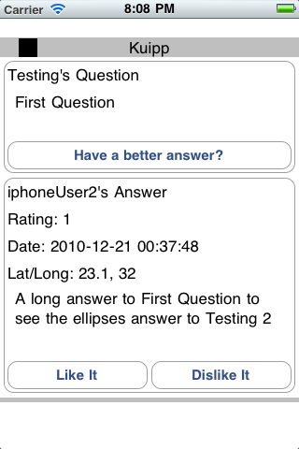
Answer
Answer
How to get here:
Directory > MyKuipps > Asked > question > answer
Or: Directory > MyKuipps > Answered > answer
Top Box
username’s question
Question
Have a better answer? – SENDS user to AnswerIt
Bottom Box
Username’s answer
rating – rating of answer
date – date of answer
GMT, need to implement timezones
lat/long – (NYI) latitude and longitude of answer
currently doesn’t find lat/long info so these won’t be right
need to change to city/region
Answer
Like It
tries to insert Like for answer to server
Dislike It
tries to insert Dislike for answer to server

Slide 19
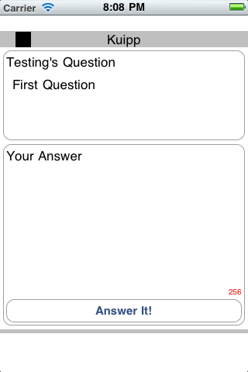
AnswerIt
AnswerIt
How to get here:
Directory > MyKuipps > Asked > question > Answer It!
Or: Directory > MyKuipps > Asked > question > answer > Have a better answer?
Top Box
username’s question
Question
Bottom Box
Answer
Answer It!
tries to insert answer to server
RETURNS user to last page
Either: Question or Answer

Slide 20
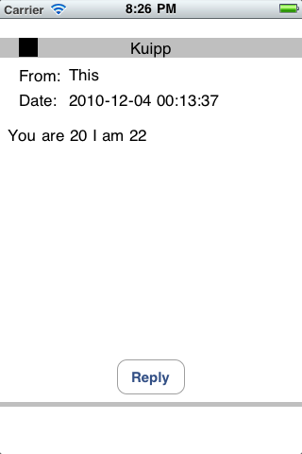
Message
Message
How to get here:
Directory > Messages > message
From – username of sender
Date – date sent
Message – message body
Reply – SENDS user to Compose with recipient as this user

Slide 21
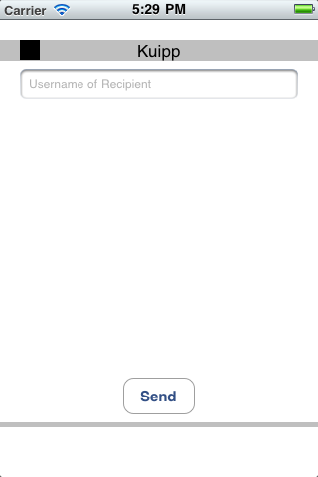
Compose
Compose
How to get here:
Directory > Messages > Compose
Or: Directory > Messages > message > Reply
Or: Profile > Send Msg
Recipient – username of recipient of message
Blank space – Text Box to write message
Send
Tries to insert message to server
RETURNS user to previous page
Either Messages or Message or Profile

